Slide 1
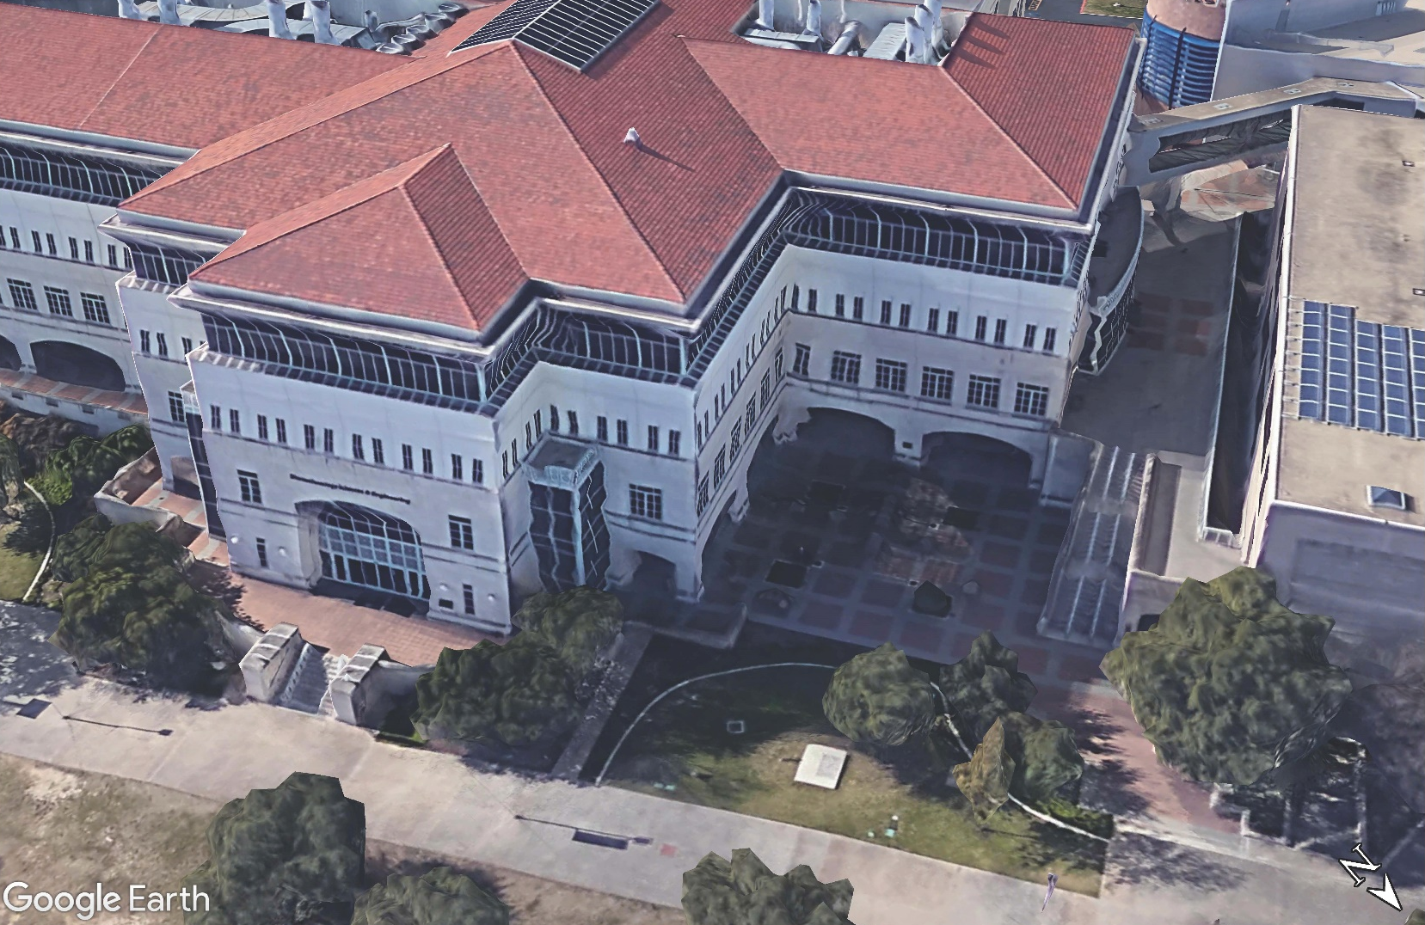
BSE Building Envelop Testing
Scaffold and Laydown Area

